Slide 1
Asset Plus By LR Model

Slide 2
 | Factor | Active% | Inactive % | Total
Age Group | Age 23 - 28 | 61.03% | 38.97% | 100.00%
Income Levels | 10 - 25 Lakh Income | 59.22% | 40.78% | 100.00%
 | 5 - 10 Lakh | 62.25% | 37.75% | 100.00%
Gender | Female | 54.06% | 45.94% | 100.00%
 | Male | 65.67% | 34.33% | 100.00%
Marital Status | Unmarried | 60.76% | 39.24% | 100.00%
Profession | Professional | 60.38% | 39.62% | 100.00%
 | Doctor | 59.48% | 40.52% | 100.00%
South India | Andhra Pradesh | 58.68% | 41.32% | 100.00%
 | Karnataka | 57.78% | 42.22% | 100.00%
 | Kerala | 58.78% | 41.22% | 100.00%
 | Telengana | 59.34% | 40.66% | 100.00%
 | Tamil Nadu | 54.97% | 45.03% | 100.00%

Slide 3
Golden Segment for Asset Plus Data:
Number | State | Age | Profession | Income | Gender | Marital Status | Start Date
1 | South India | 23 - 28 | Professional | 10 - 25L | Female | Unmarried | 2017 & 2018
2 | South India | 23 – 28 | Professional | 5 – 10L | Male | Unmarried | 2018

Slide 4
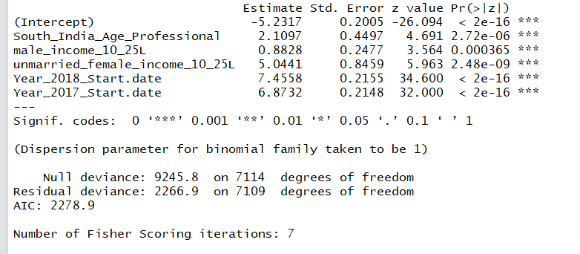
Summary by LR Model

Slide 5
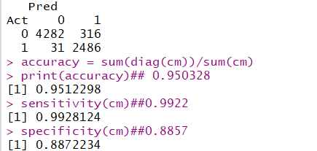
Confusion Matrix and Accuracy

Slide 6
Golden Segment 1
Women who are unmarried with Age group 23 – 28 with Income of 10 – 25Lakh of Profession Professional from South India

